Slide 1
Supervised learning
Presentation 1: Analysis on mtcars data
Tilak Poudel
Roll no: 39

Slide 2
Load data and divide into training and testing data
data = mtcars
str(data)
# Set seed for reproducibility
set.seed(39)
# Data partition
ind <- sample(2, nrow(data), replace = T,prob = c(0.7, 0.3))
train_data <- data[ind == 1,]
test_data <- data[ind == 2,]
> str(data)
'data.frame': 32 obs. of 11 variables:
> names(data)
[1] "mpg" "cyl" "disp" "hp" "drat" "wt" "qsec" "vs" "am" "gear" "carb"
> table(ind)
ind
1 2
25 7

Slide 3
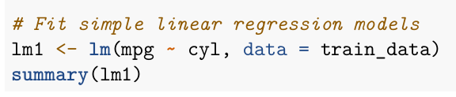
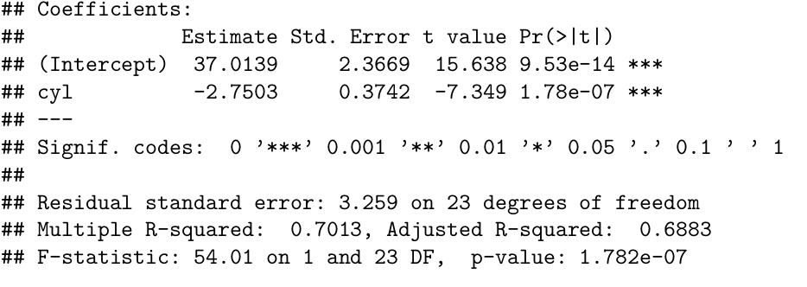
2. Fit linear model on training data (mpg as dependent and other as independent variable)
The p-value(1.782e-07) is less than 0.05, indicating that the model is statistically significant. The R-squared
value is 0.7013 (>0.5), which means that 70.13% of the variance in mpg can be explained by the number of
cylinders (cyl). The model is BLUE (Best Linear Unbiased Estimator).

Slide 4
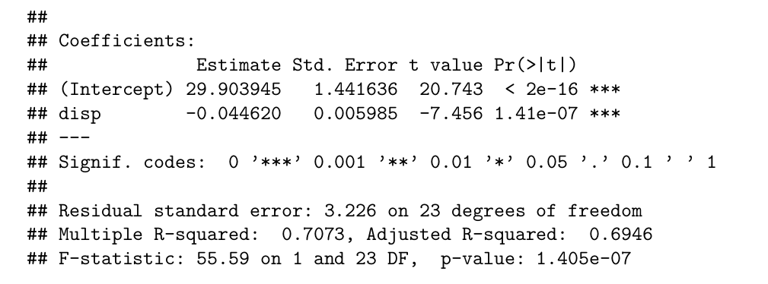
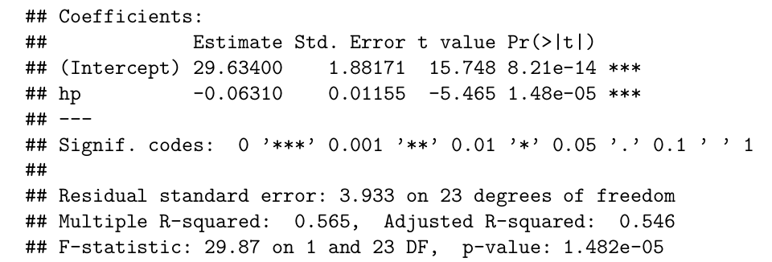
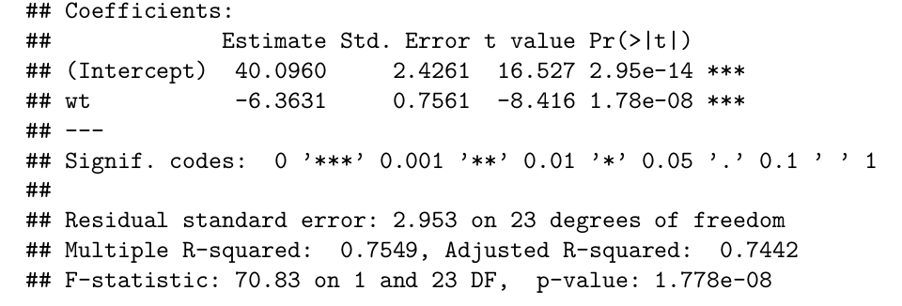
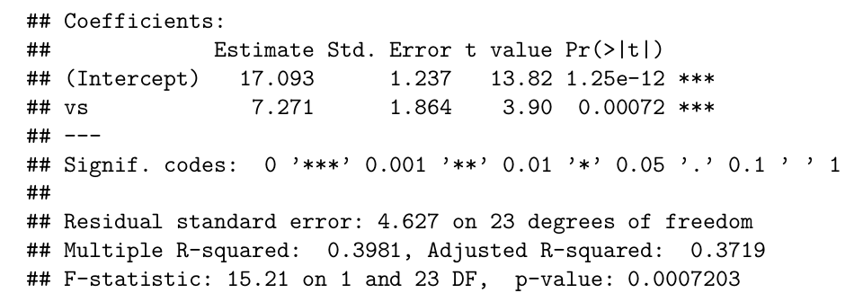

Slide 5
3. Statistically significant variables

Slide 6
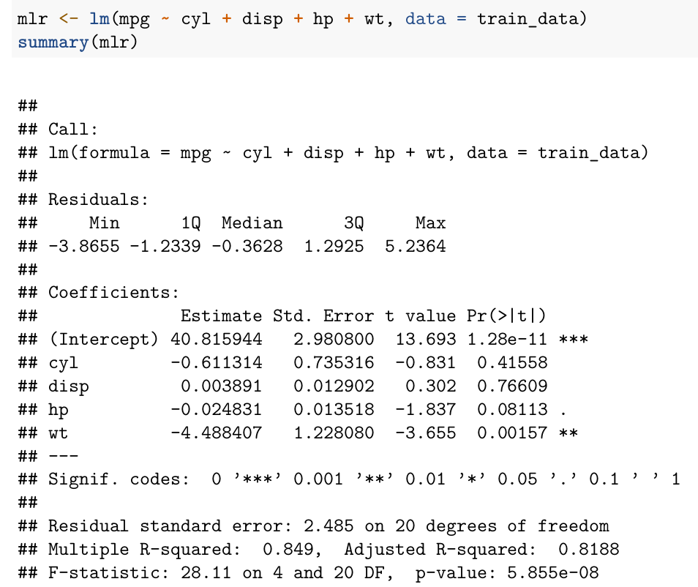
4. Fit the multiple regression model with significant variables

Slide 7
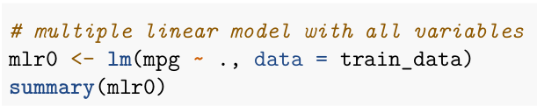
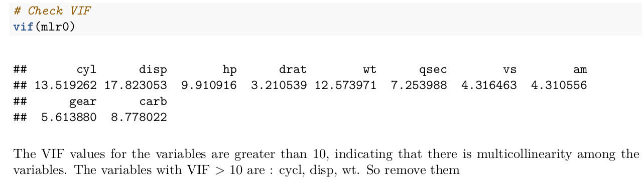
5. Get VIF of all variables

Slide 8
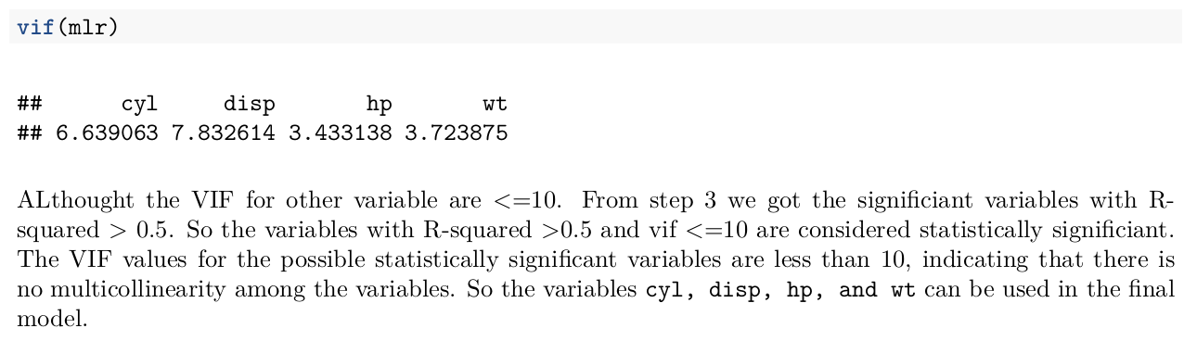

Slide 9
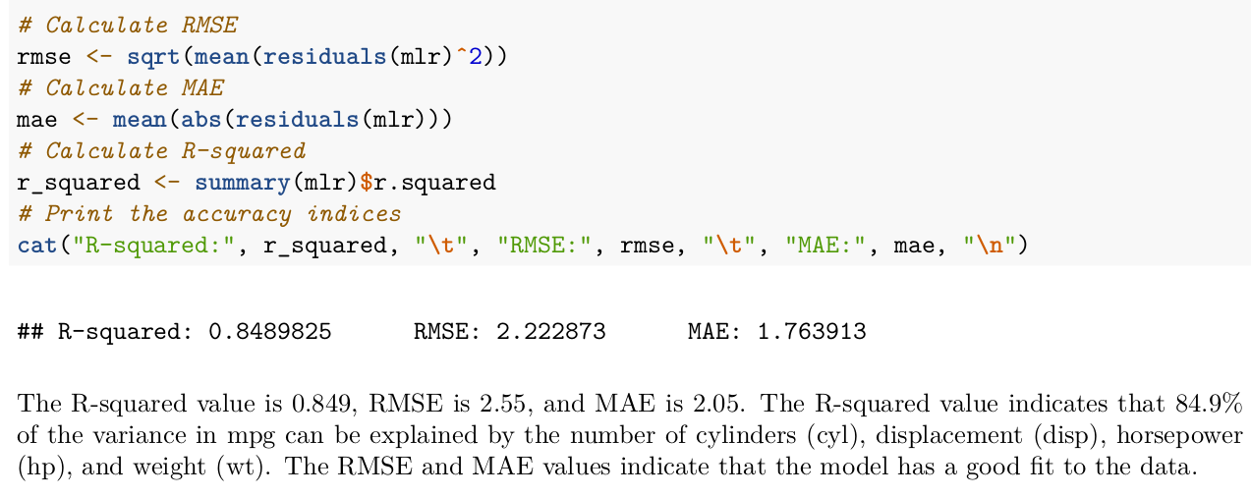
6. Get Summary and accuracy indices

Slide 10
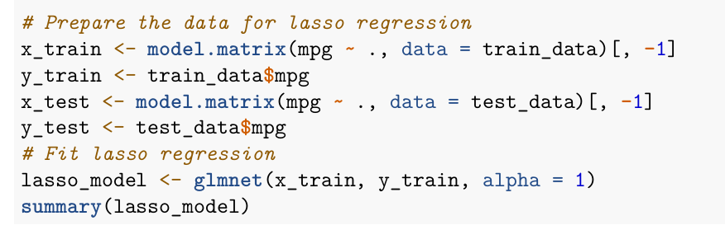
7. Use lasso regularization to deal with multicollinearity

Slide 11
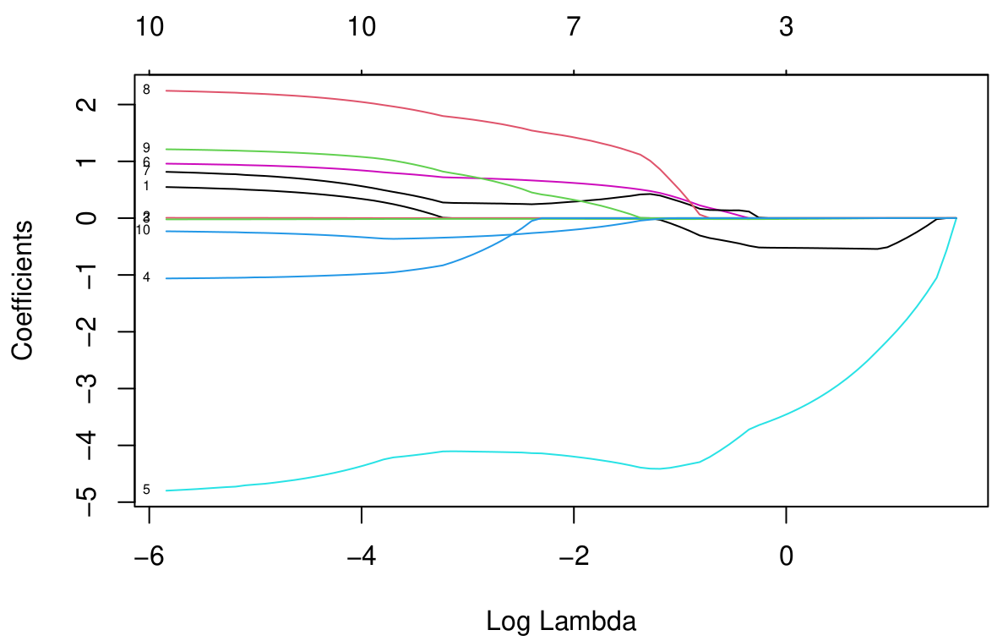
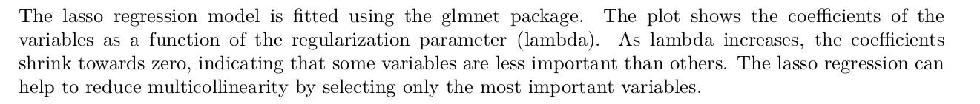

Slide 12

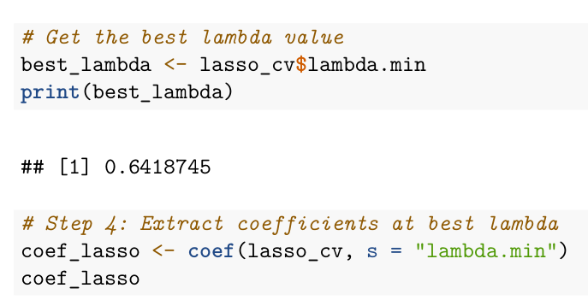

Slide 13
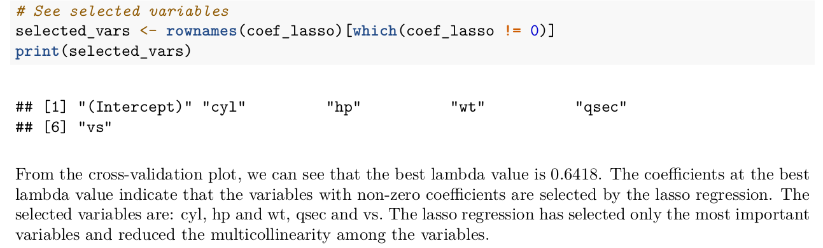

Slide 14
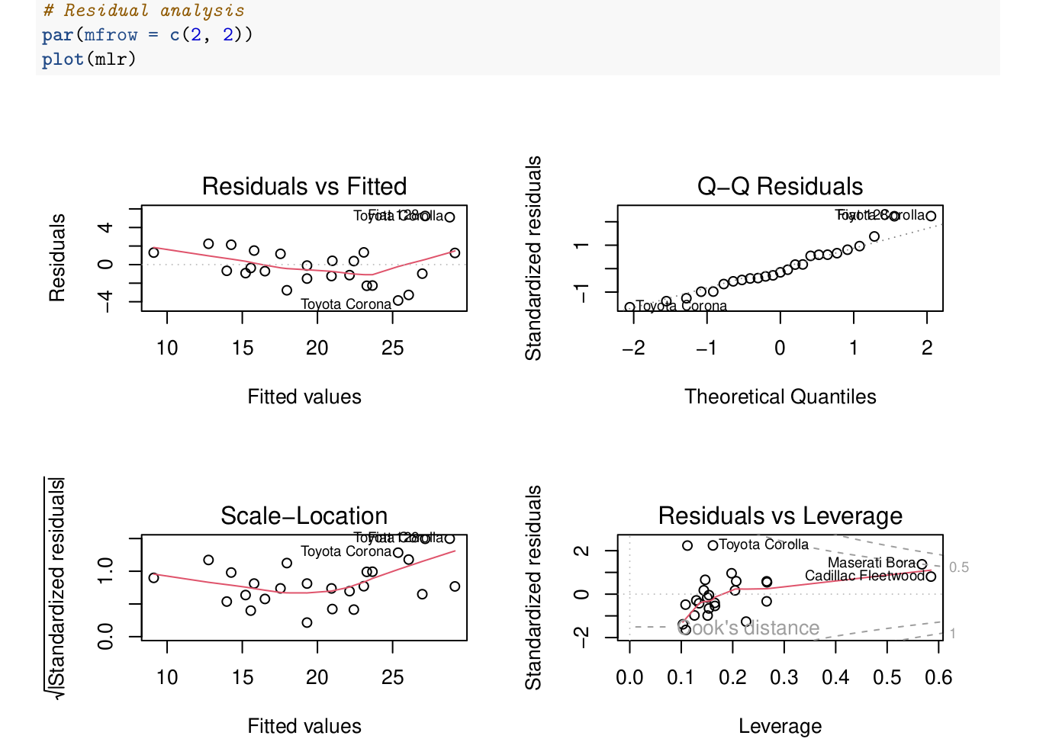
8. Residual Analysis using LINE tests

Slide 15
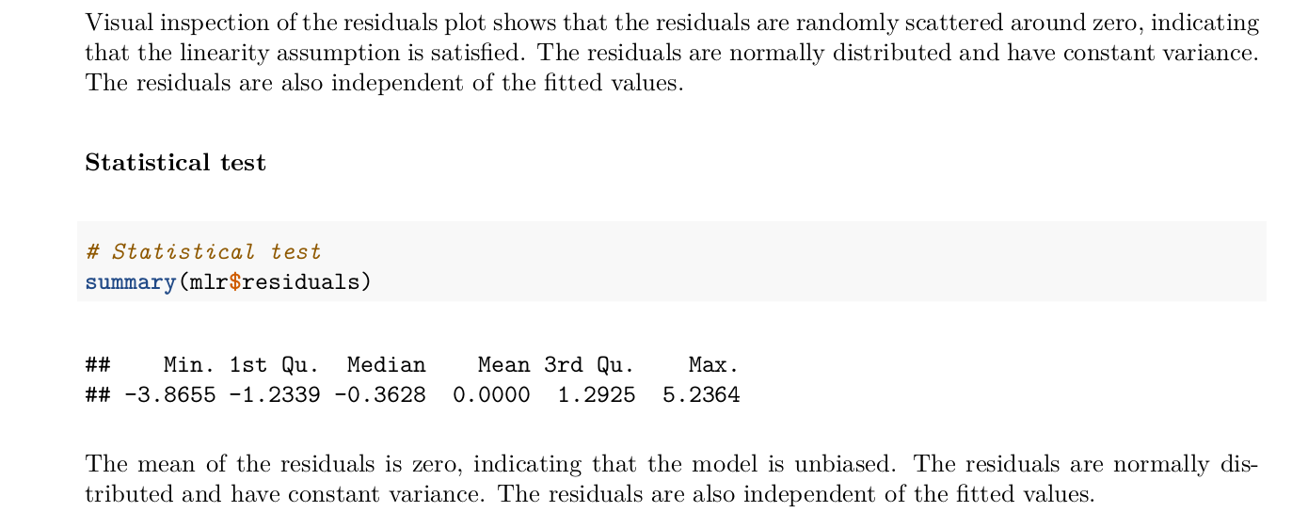
Linearity test

Slide 16

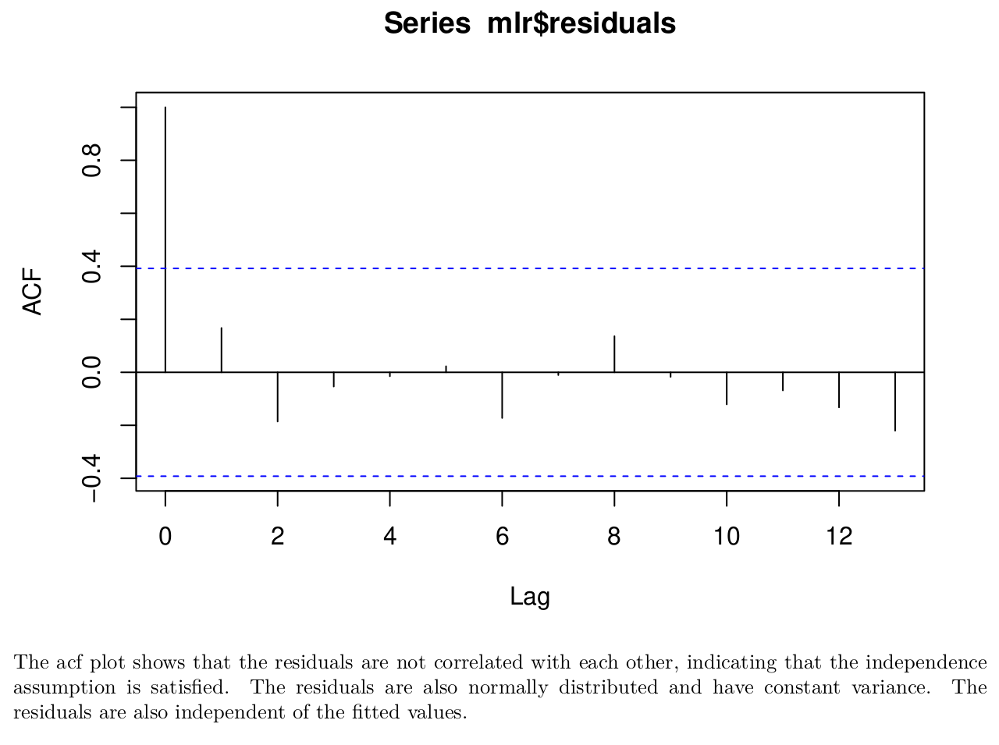
2. Independence of residuals test

Slide 17
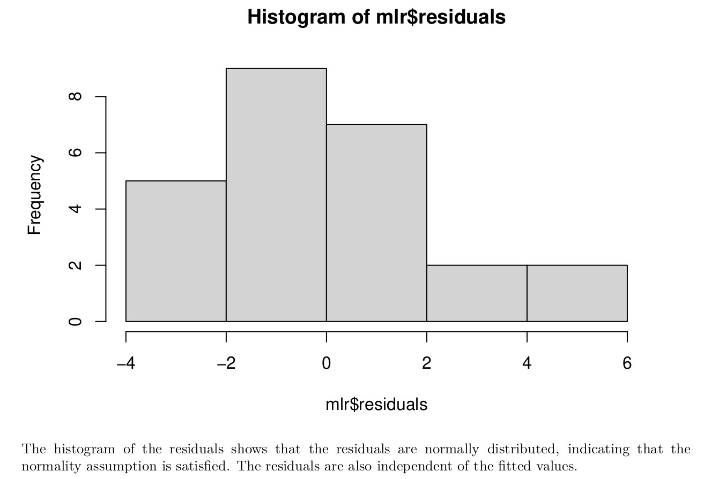

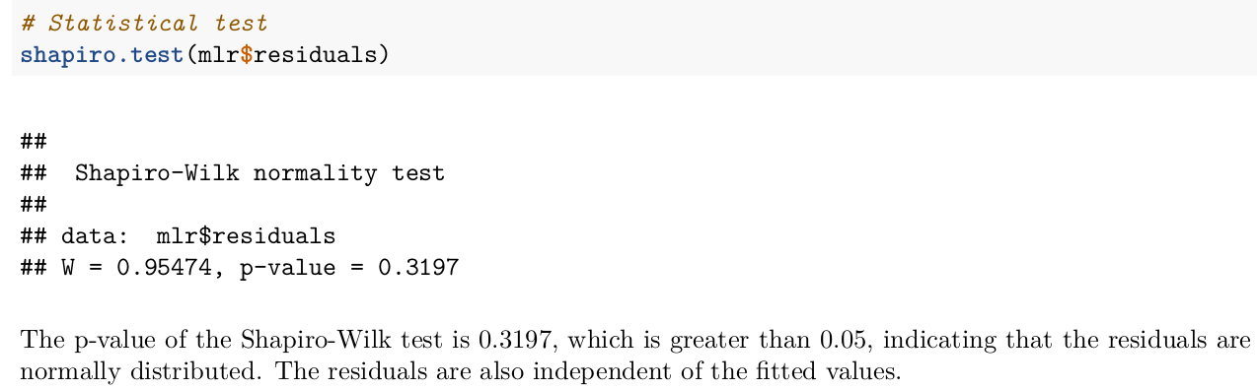
3. Normality test

Slide 18
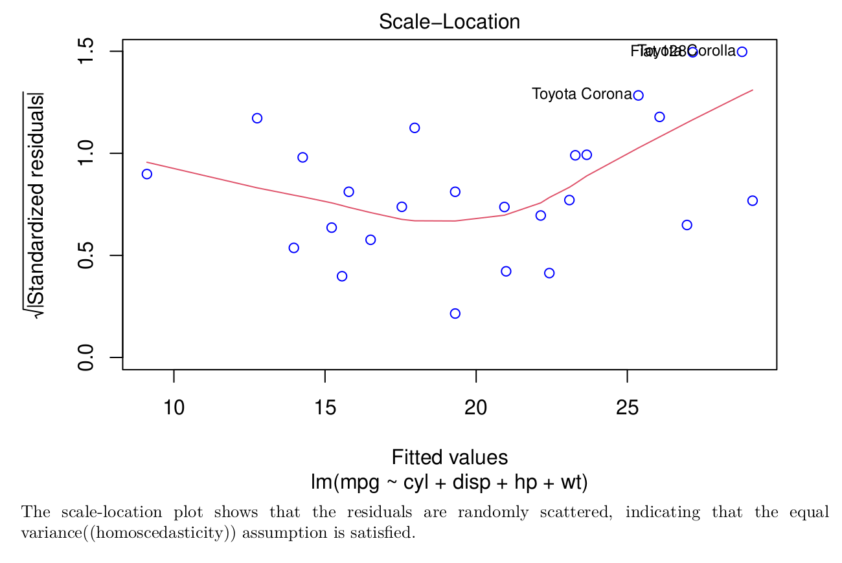

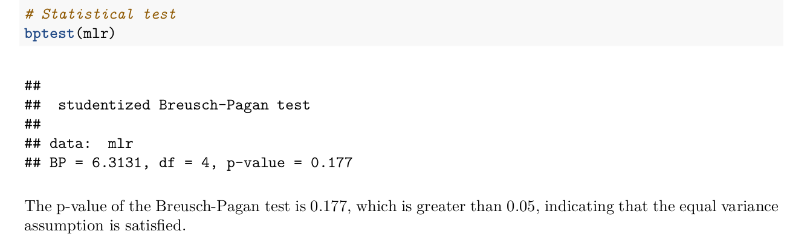
4. Equivariance (homoscedasticity) test

Slide 19
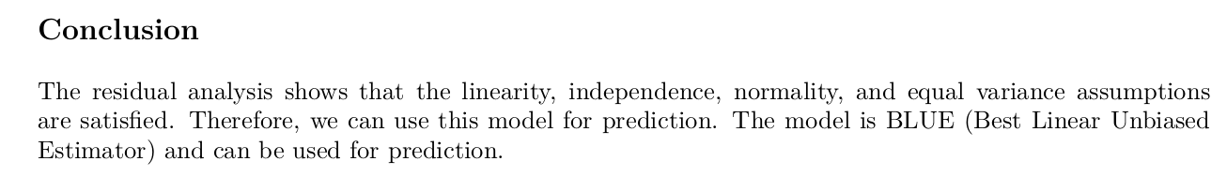

Slide 20
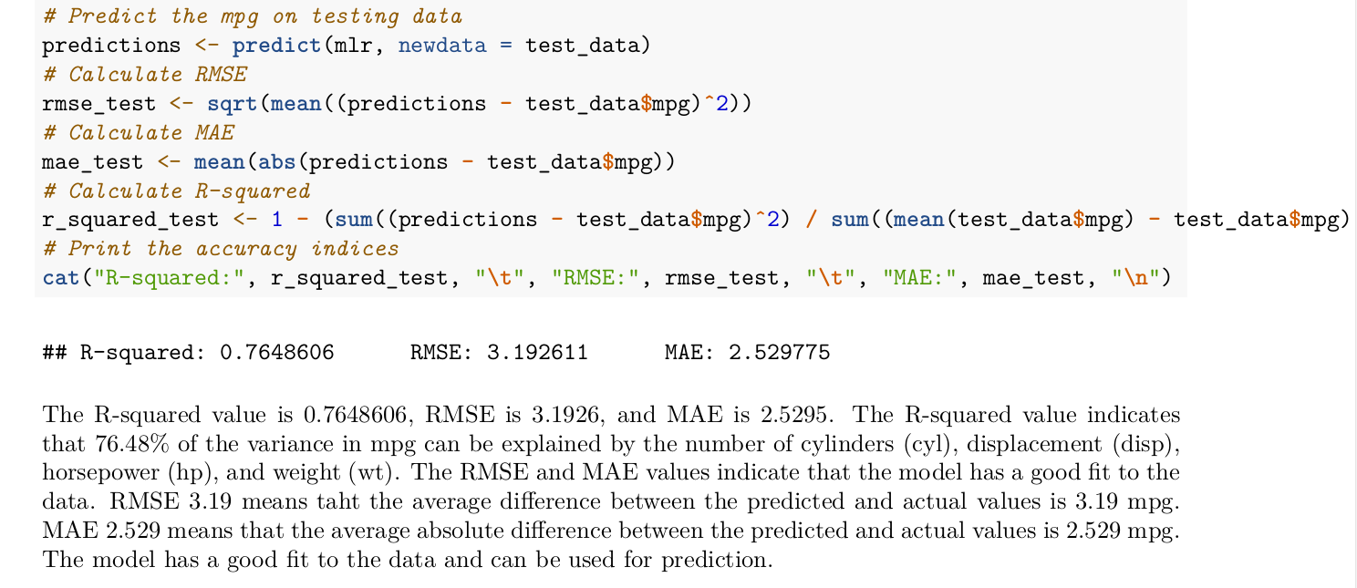
9. Predict mpg on testing data, get accuracy indices

Slide 21
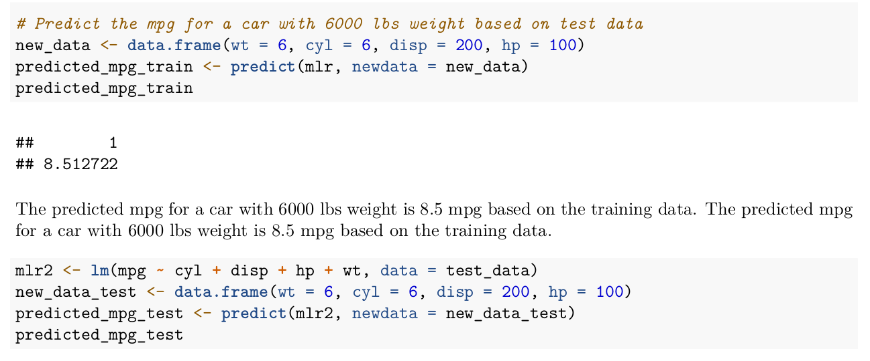
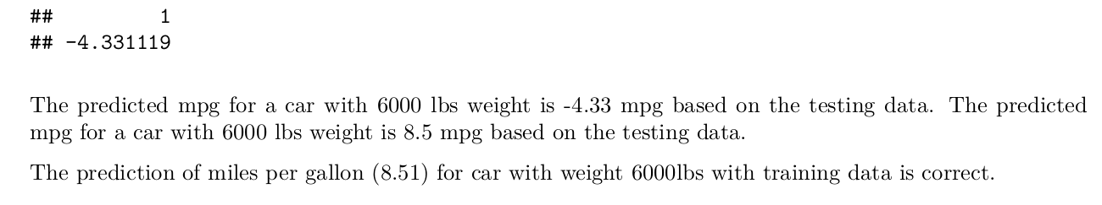
10. Predict mpg for 6000 lbs weight

Slide 22
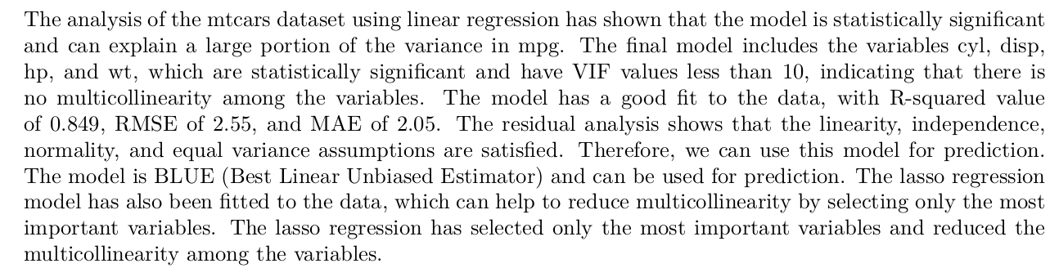
Summary

